Slide 1
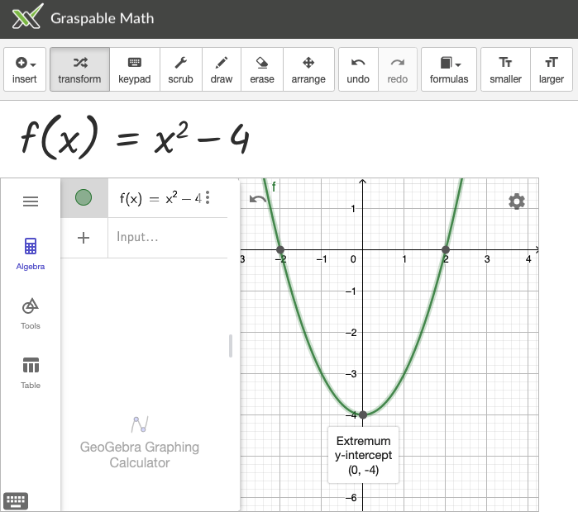
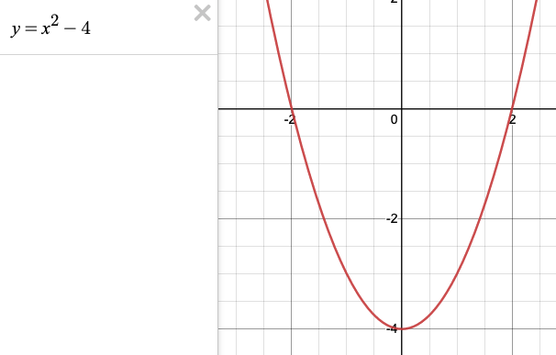
Graspable Math and Geogebra
This shape is a parabola
Desmos graph

